Slide 1
VISUALIZING EMPLOYEE ATTENDANCE TRENDS WITH EXCEL CHART
STUDENT NAME: SRI BHARATHI K
REGISTER NO:312217064 (asunm1659312217064)
DEPARTMENT:B.COM (GENERAL)
COLLEGE:SHRI KRISHNASWAMY COLLEGE FOR WOMEN

Slide 2
VISUALIZING EMPLOYEE ATTENDANCE TRENDS WITH EXCEL CHART

Slide 3


AGENDA:
Problem Statement
Project Overview
End Users
Our Solution and Proposition
Dataset Description
Modelling Approach
Results and Discussion
Conclusion
3/21/2024 Annual Review

Slide 4

PROBLEM STATEMENT:
Visualizing Employee Attendance Objective: Design a data visualization dashboard to track and analyze employee attendance patterns, providing insights to optimize workforce planning and productive

Slide 5

PROJECT OVERVIEW:
Create an interactive dashboard to track and analyze employee attendance patterns, providing insights to optimize workforce planning, productivity, and attendance.
.

Slide 6

WHO ARE THE END USERS?
1. HR Managers 2. Department Managers 3. Operations Leaders 4. Employee Engagement Teams 5. Business Analysts 6. Executives These users will benefit from the attendance insights and visualizations.

Slide 7

OUR SOLUTION AND ITS VALUE PROPOSITION:
Solutions: 1. Interactive Dashboard 2. Attendance Analytics 3. Customizable Reports 4. Employee Scorecard Value Propositions: 1. Data-Driven Decision Making 2. Improved Productivity 3. Enhanced Employee Engagement 4. Reduced Absenteeism

Slide 8
Dataset Description:
- Employee ID - Name - Date - Attendance Status - Department - Job Title - Location _CSV or Excel, 6+ months, 10k-50k rows_

Slide 9

THE "WOW" IN OUR SOLUTION:
- Real-time tracking - Interactive dashboards - AI-powered insights - Automated reporting - Employee engagement tools - Mobile accessibility - Seamless integrations These features bring a modern and innovative approach to employee attendance management.
3/21/2024 Annual Review
9

Slide 10
MODELLING
Modeling: 1. Data Prep 2. Pattern ID 3. Predictive Modeling 4. Visualization Models: 1. Descriptive 2. Diagnostic 3. Predictive 4. Prescriptive
10

Slide 11
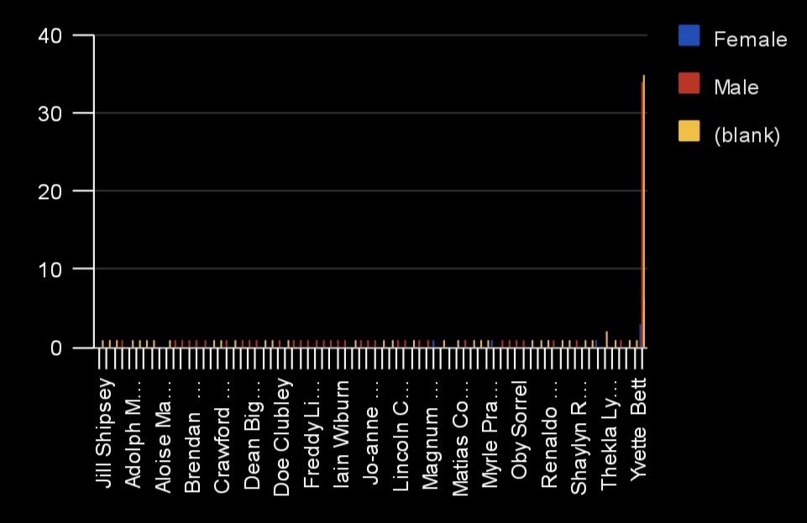
RESULTS :
11

Slide 12
Conclusion:
Visualizing employee attendance drives data-driven decisions, improving: - Attendance and reducing absenteeism - Workforce planning and scheduling - Employee engagement and productivity Transforming attendance management from reactive to proactive.

